Slide 1
Academic Honesty
CS 1100: Computer Science and Its Applications

Slide 2
Why is academic honesty important??
Your diploma represents the University’s certification that you have attained a certain level of knowledge in your program.
Your grade in this course represents our certification that you have attained a certain level of knowledge in this course.
YOU means you, not you with a little help from your friends.
© Mitchell Wand, 2012-2013. This work is licensed under a Creative Commons Attribution-Non-Commercial 3.0 Unported License.

Slide 3
Who cares?
Employers care.
When they see a Northeastern diploma, they expect that individual to have reached a certain level of achievement.
Faculty and Advisors care.
When they see a grade in this course, they expect that individual to have reached a certain level of knowledge.

Slide 4
Who else cares?
Your classmates care.
An honest student gets upset when his or her classmate gets a reward without putting in the effort.
The University cares.
Every time a student goes out into the world with a Northeastern University diploma and doesn’t perform well, it makes the whole university look bad.

Slide 5
Khoury college cheating policy
All violations of the University academic integrity policy MUST be reported to the Office of Student Conduct and Conflict Resolution (OSCCR).
Students who cheat often do so in multiple courses. By reporting all violations to OSCCR, we guarantee such students are suitably punished.

Slide 6
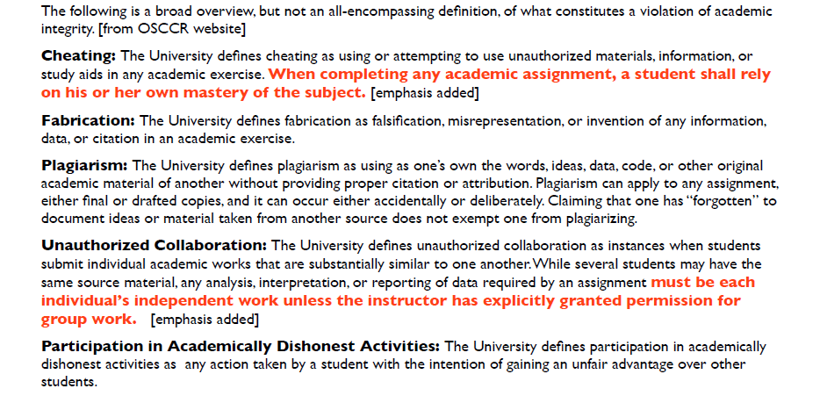
University academic integrity policy

Slide 7
The short version: Don’t share bits
If you share files, or even portions of files, with somebody else, we will detect it and you will get reported to OSCCR.
Period.
End of story.

Slide 8
Typical scenario
Your friend comes and says s/he is lost and the problem is due tomorrow and can s/he just please look at your solution or how you did the work.
What should you do?

Slide 9
Typical scenario
Your friend comes and says s/he is lost and the problem is due tomorrow and can s/he just please look at your solution or how you did the work.
What should you do?
Tell him/her the University policy requires you to tell him/her NO.
If you give her/him your files, YOU will be sent to OSCCR.
And of course s/he will be sent to OSCCR.

Slide 10
Another typical scenario
The problem is due tomorrow and your roommate has solved the problem.
Your roommate left her/his machine unlocked, and you are still struggling.
You think: I’ll just peek at the roommate’s solution.
Or you may think: I’ll just mail myself a copy so I can look at it more closely.
What should you do?

Slide 11
Another scenario
Don’t do it.
You WILL be sent to OSCCR.
You punishment may be harsher because theft is much worse than collaboration.

Slide 12
A third scenario
You are sitting in the library with a group of people and you write some examples on the whiteboard.
And then you all submit the same examples, perhaps with the numbers changed.
What will happen next?

Slide 13
A third scenario
You are sitting in the library with a group of people and you write some examples on the whiteboard.
And then you all submit the same examples, perhaps with the numbers changed.
What will happen next?
You all will be sent to OSCCR.

Slide 14
A fourth scenario
You and a classmate share a USB drive.
You submit your classmate’s file as your own. You even renamed it.

Slide 15
A fourth scenario
You and a classmate share a USB drive.
You submit your classmate’s file as your own. You even renamed it.
You will both be reported to OSCCR.
Each student is responsible for keeping her or his code hidden from all other students, which is violated when a USB stick or drive is shared.

Slide 16
What happens if I get caught?
You will be called to your professor’s office and you will be shown what you did.
You will receive a grade penalty in the course.
You will be reported to OSCCR.
They will assign a non-academic penalty (typically some form of suspension, possibly deferred if there are no future violations.
A second OSCCR violation typically results in expulsion from the University.

Slide 17
What happens if you don’t get caught and get away with it?
You go on to the next course and do poorly because you are unprepared.
You go out on an interview and do poorly because you are unprepared.
You manage to get a job, but do poorly because you are unprepared.
Your co-op employer is so disappointed by your performance that they decide not to interview any more Northeastern students.

Slide 18
Personal responsibility
We know students who are under time pressure are far more likely to resort to theft.
Time pressure or stress is not an acceptable excuse.
The measure of character is not what you do when things are easy; it is what you do when things get tough.

Slide 19
Avoid the problem
Guard your work!
If you keep your work on your home machine, be sure your machine is secure – both from internet hostiles and from your roommates, etc.
It only takes a minute for your roommate, or for the person sitting next to you in the hallway, to stick a USB drive in your machine and steal your work.
DON’T DISCOUNT THIS. We have encountered theft by roommates on a regular basis in the past.
Remember that physical security is a prerequisite for information security.

Slide 20
Sorry about all that
We know most of you are honest and none of this will apply to you.
But cheating happens often enough that we need to have policies about it and you need to know them.
If you have any questions about any actions that you do or are thinking about, please talk to your professor immediately.

